Slide 1



On the Possibility of Gravitational Lensing of Terra Electron-volt Gamma Ray Sources
Sean Gellenbeck
Mentor: Professor Ann Zabludoff, Steward Observatory
21st Annual Arizona/NASA Statewide Space Grant Undergraduate Research Internship Program Symposium
University of Arizona, Tucson, Arizona
April 21, 2012

Slide 2
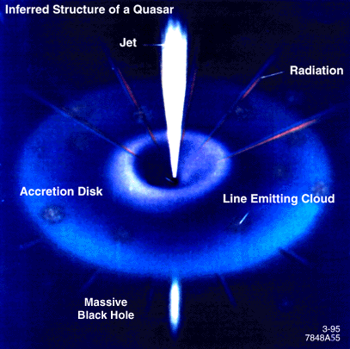



Motivation (Structure of Blazars)
Electron-volt (eV) = Energy
Terra (T)- = 1 trillion eV
1 TeV – about equal to the kinetic energy of a flying mosquito
Terra electron-volt (TeV) gamma ray sources, a mystery
Blazars?
Image Credit:
http://heasarc.gsfc.nasa.gov/docs/cgro/images/epo/gallery/agns/index.html
Notes:
Explain basic Ideas. Mosquito point - Distances on order of 10^22 miles

Slide 3
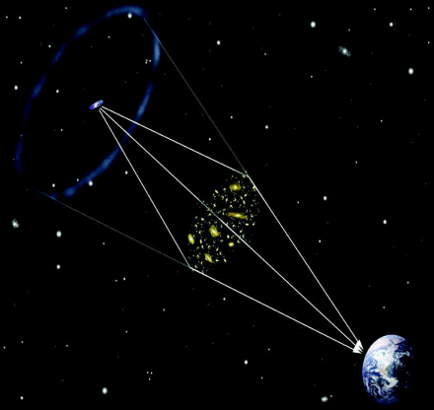
Motivation (Gravitational Lensing)
Efforts to understand sources futile if properties biased
Gravitational lensing can cause bias
Foreground mass can magnify light from background sources
Image Credit:
http://www.lsst.org/files/img/Soares-Grav_Lens.jpg
Notes:
Explain GL. Newton’s law of Gravitation. Checking to see if GL is happening. NOT TO SCALE!!!

Slide 4
Methods/Results Possible Lensing (Blue) vs. Unlikely to be Lensed (Green)
TeV Flux Distribution (Crab Units)
Number of Sources
Optical Magnitude Distribution (Magnitude)
Number of Sources
14 14.6375 15.275 15.9125 16.55 17.1875 17.825 18.4625 19.1
Notes:
Used NED and TeVCat. Explain graphs. Averages show that GL not bias on average.

Slide 5
Preliminary Conclusions and Future Directions
On average, gravitational lensing does not bias TeV sources
It could have an effect individual sources – verifying using lensing models
Future Goals:
Secure additional redshift data on foreground objects
Publish significant conclusions
Notes:
more work to do. Plan to finish what I started.

Slide 6
Thank You!
Sean Gellenbeck
Department of Aerospace and Mechanical Engineering
gellenbs@email.arizona.edu
Notes:
THANK YOU!!! Look to moderator to field questions!

